Slide 1
ZOE Presentation Assets
Diagrams/Charts
10 June 2020
Bellsy Design Ltd.

Slide 2
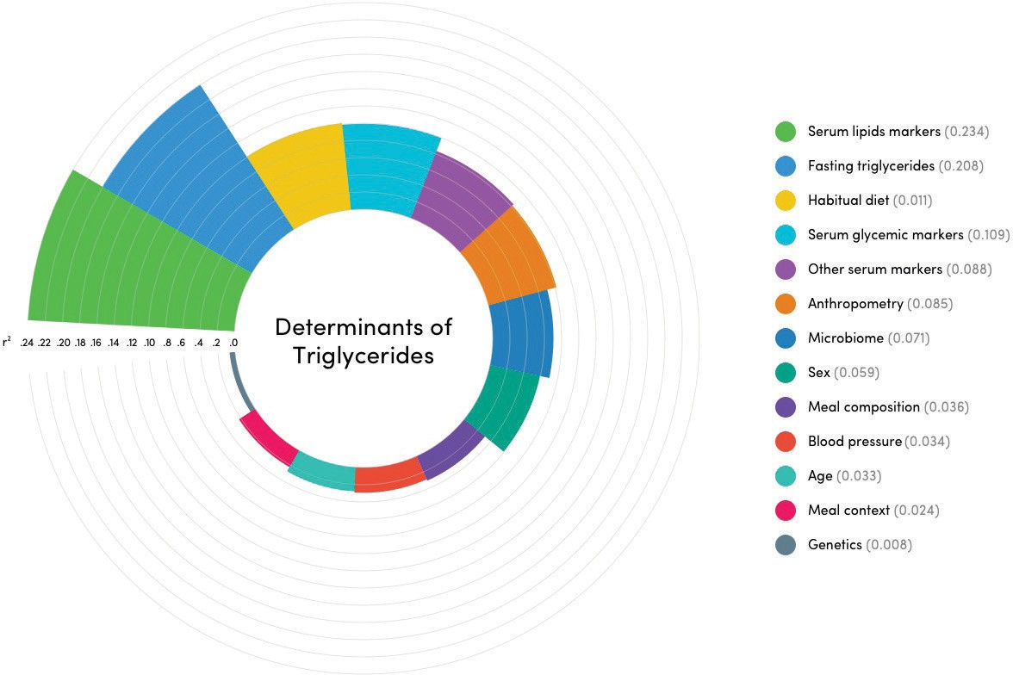
Triglycerides
Fan

Slide 3
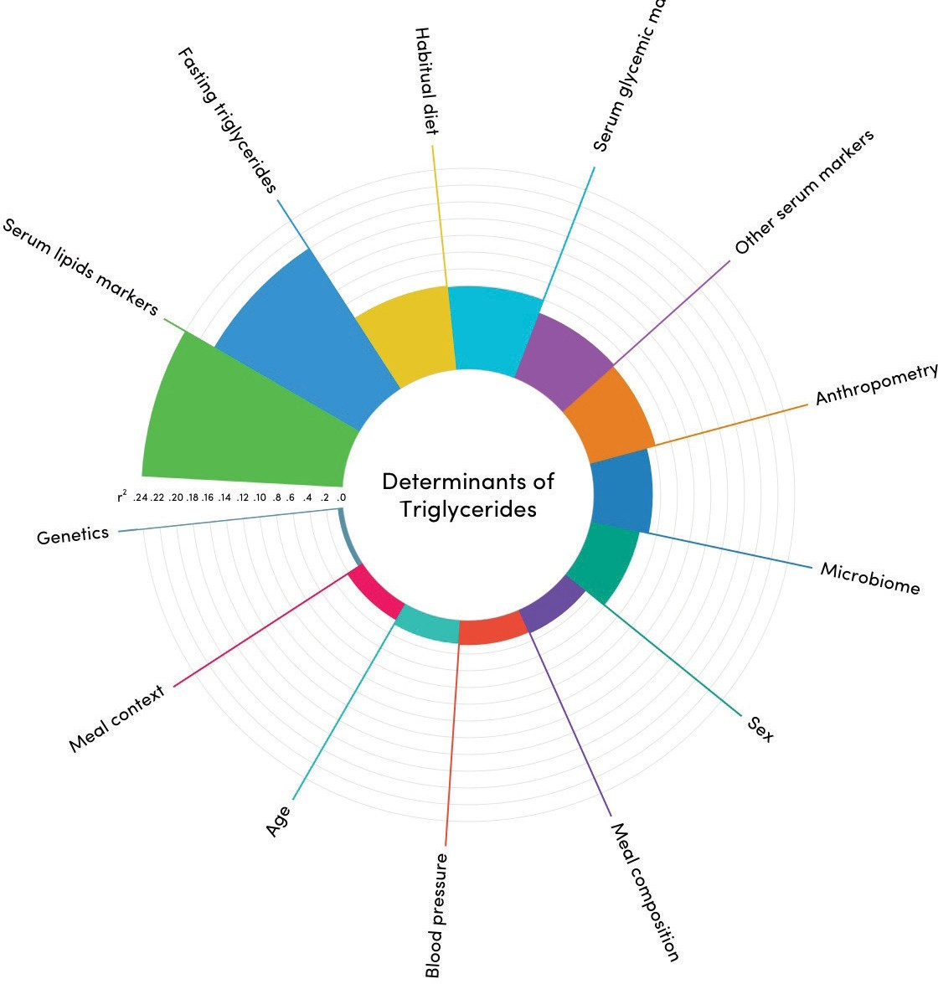
Triglycerides
Spider

Slide 4
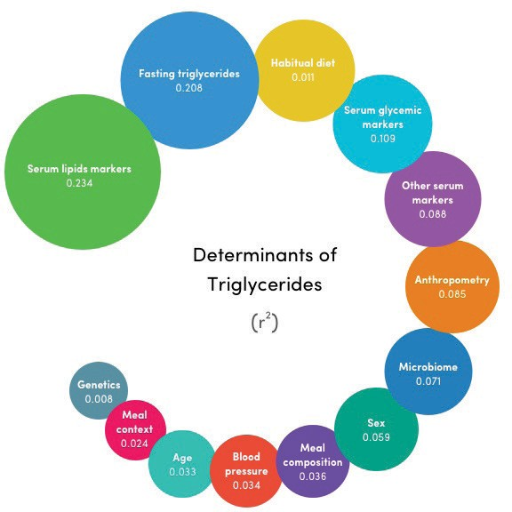
Triglycerides
Bubbles

Slide 5
Glucose
Fan

Slide 6
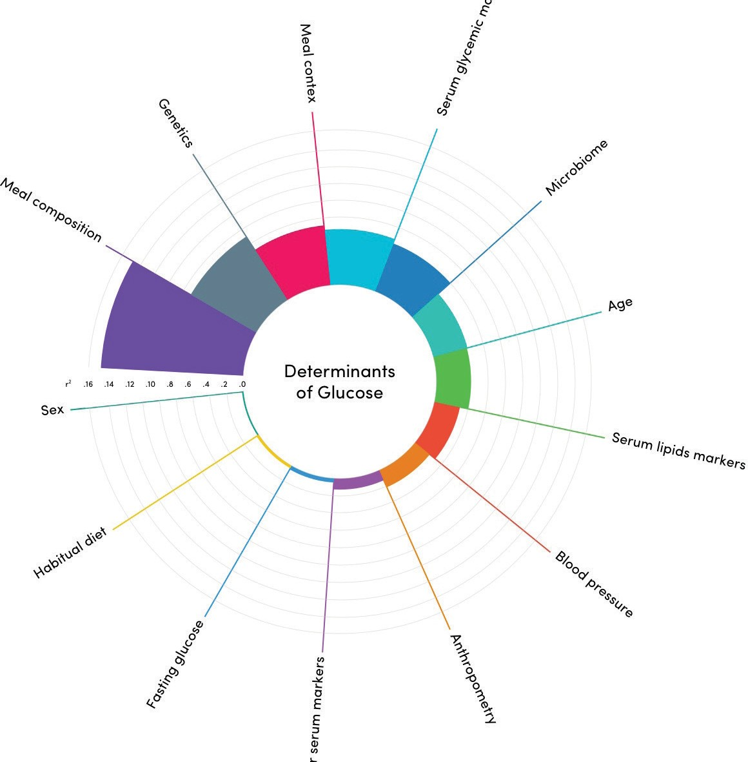
Glucose
Spider

Slide 7
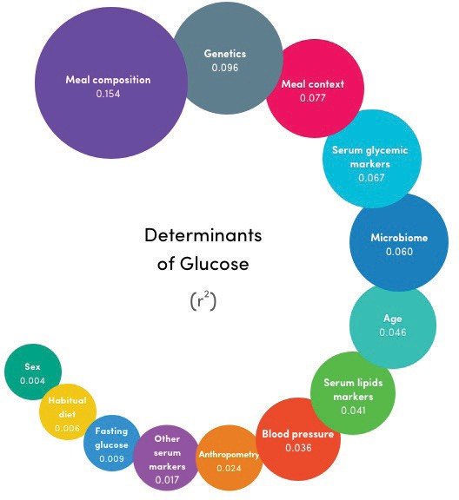
Glucose
Bubbles

Slide 8
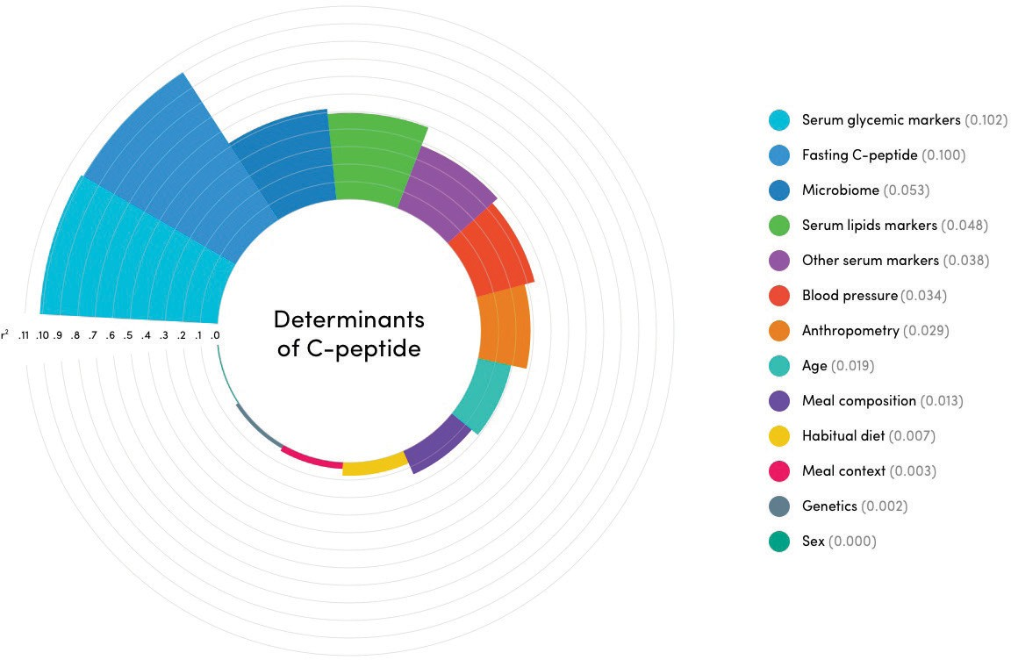
C-peptide
Fan

Slide 9
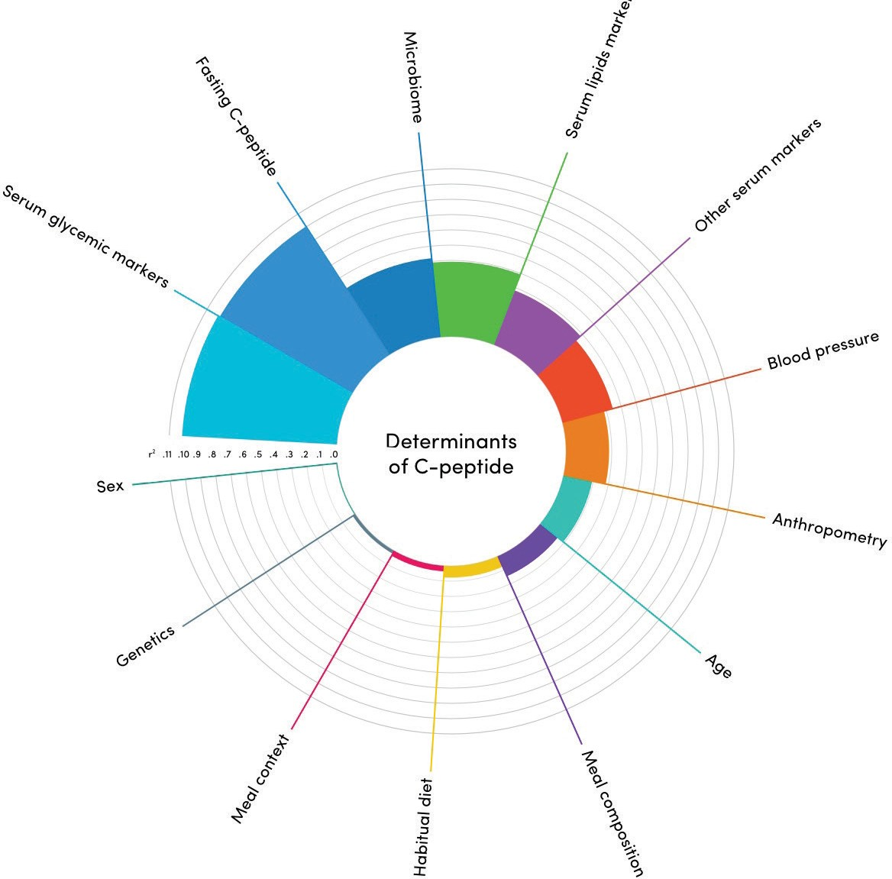
C-peptide
Spider

Slide 10
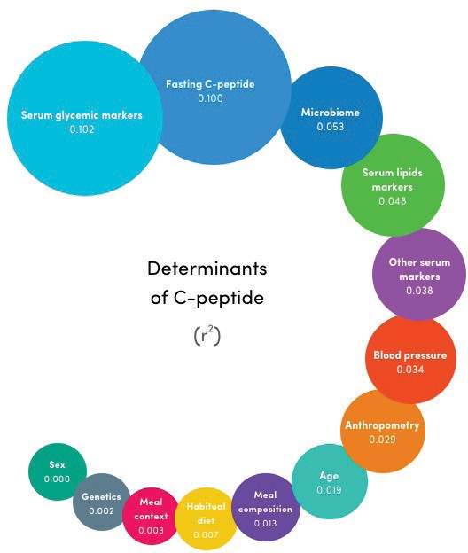
C-peptide
Bubbles

