Slide 1
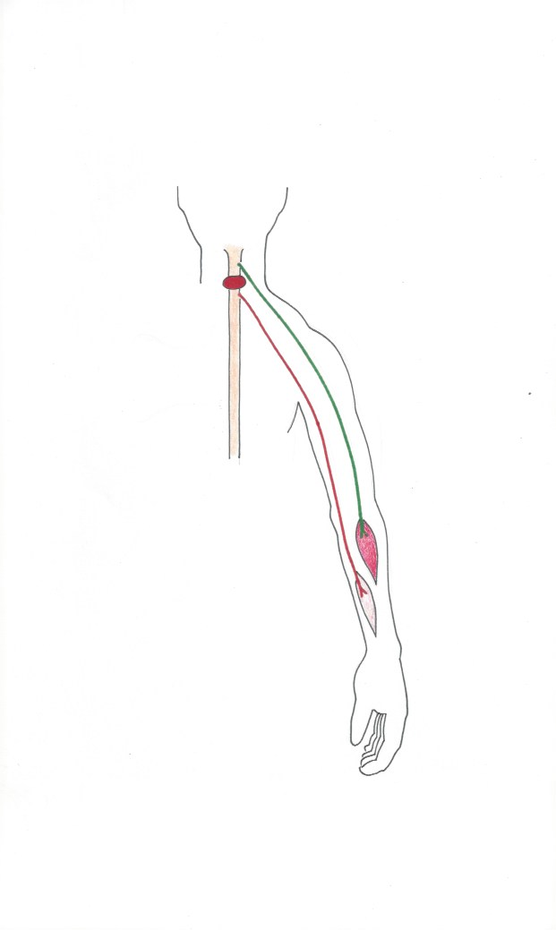
Pre Operation
Normal, expendable nerve supplied above the SCI
Spinal cord injury (SCI)
Normal, expendable muscle
Non-functional nerve below the level of the SCI
Important, paralysed muscle

Slide 2
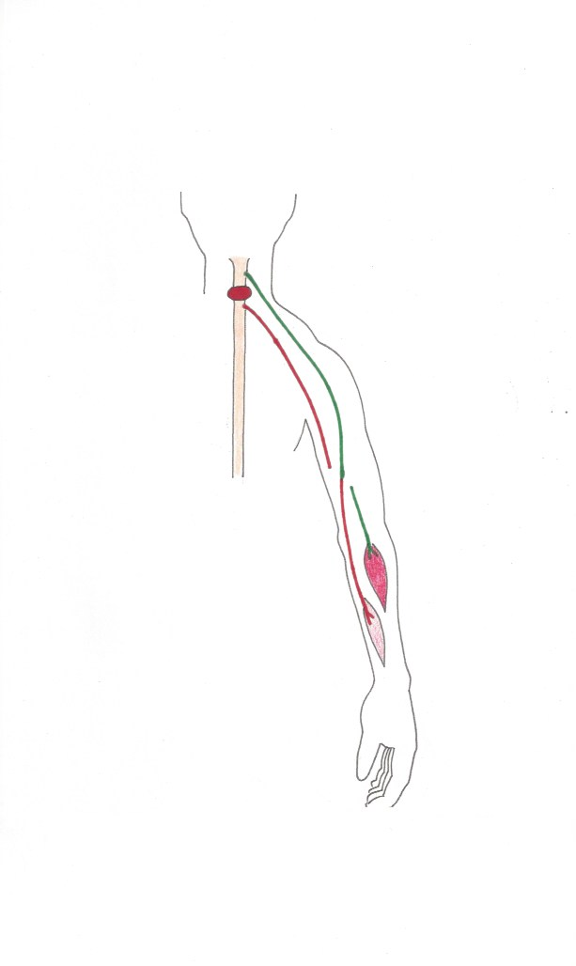
Operation
Normal nerve cut and joined using microsurgical techniques to….
…the non-functional nerve

Slide 3
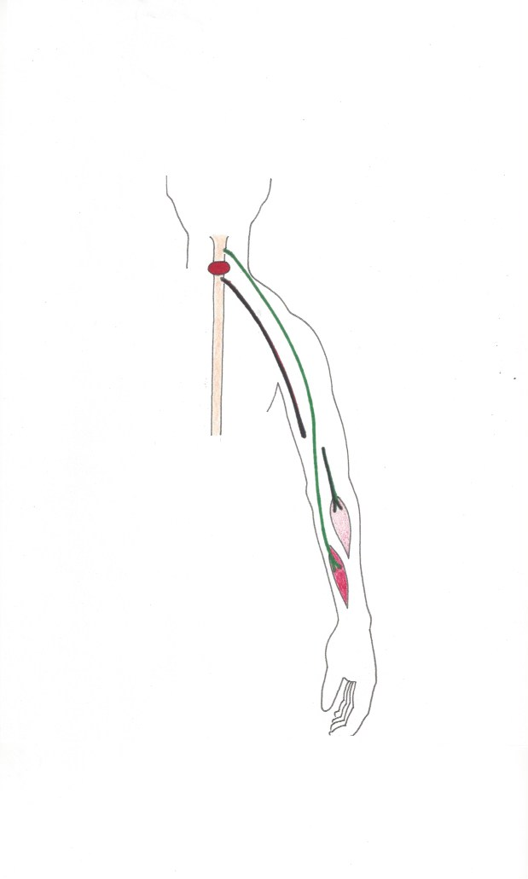
Post operation
Axons from the normal nerve grow down towards the paralysed muscle
Paralysed muscle is
re-animated

